Slide 1
Creating Better Ideas
with a focus on Advertising

Slide 2
Research
Know everything there is to know about the brand
Google the Brand
Study the business and competition
Understand the Brand’s current positioning
Listen to the users of the brand
Understand the users culture(s)
Make the brand apart of your life
“Method Acting”

Slide 3
Strategy
Find your Insight
Basic Human Truth
Oh yeah? So what?
“Vague strategies inhibit, precise strategies liberate”

Slide 4
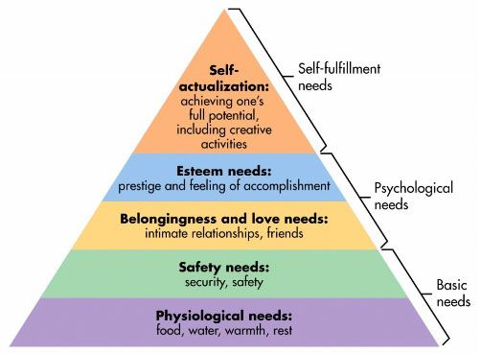
Maslow

Slide 5
Consumer Adoption Process
Awareness
Education
Trial
Purchase
Liking
Repurchase
Loyalty

Slide 6
Pen and Paper
Close your laptop
Focus and think
Quantity produces Quality
Write down everything
No idea is a bad idea, but stay near strategy
Foster an atmosphere of positivity
Ask more questions
Word/Image/Emotional Association
Art focus or Copy focus?

Slide 7
Your Preferences
Find and embrace your “happy place”
Loud or Quiet?
Music or No Music?
With People or Without People?
Coffee or No Coffee?
3PM or 3AM?
Cafe? Park? Car? Shower? Bed? After a nap? Home? Exercise?

Slide 8
General Tips
Start big, cut small
All ideas sound worse than they look
Tell a story
Simplicity almost always wins
Listen
Live life so you can pull from those experiences
Take care of yourself

Slide 9
General Recommendations
Stay up to date with pop culture
Follow the news
Study basic psychology or sociology
Study advertising history and award shows
Study art history
Read occasionally
Write or doodle often, always carry pen and paper

Slide 10
Sources
Hey Whipple, Squeeze This, Luke Sullivan
Advertising Concept and Copy, George Felton
The Advertising Concept Book, Pete Barry
Professor Jeff Williams
Dr. Carol Pardun

